Slide 1



DATA ANALYTICS PROJECT
ZOMATO

Slide 2


Our Team Members
Ravi Kiran G
Gaurav kumar
Ansuman Paramguru
Aditya Wankhade
Chanikya Vallepu
Sanket Kshirasagar

Slide 3

This project focuses on analyzing restaurant and food delivery data to uncover key insights into customer preferences, restaurant performance and market trends.
By examining customer ratings, reviews, cuisine popularity and delivery efficiency the project aims to provide actionable insights for restaurant owners and the Zomato platform.
Using tools like SQL, Excel, Tableau, and Power BI the analysis identifies high-performing restaurants, customer sentiment.
The project helps in optimizing restaurant listings, improving customer satisfaction and enhancing decision-making processes in the online food delivery ecosystem.
DATA OVERVIEW

Slide 4

OBJECTIVE
To analyze restaurant and food delivery data for actionable insights that enhance decision-making. The project aims to understand customer preferences, improve restaurant performance, enhance customer experience and optimize delivery efficiency. It helps businesses identify trends, improve service quality and make data-driven decisions to boost growth and customer satisfaction.

Slide 5









Project Workflow
1. Extract Data/Import Files
2. EData Cleaning & Transformation
3. Data Modeling
4. KPI And Visualization
5. Dashboard

Slide 6
1. Total Restaurant
2. Total City
3. Average Rating
4. Total Cuisines
5. Total Votes
6. Resturant count by Country and City
7. Resturants opening based on Year , Quarter , Month
8. Percentage by “Has table booking” & “Has online delivery”
KPI’s

Slide 7
KPI Card
📌 Definition: The total number of restaurants listed on Zomato over time.
📌 Importance: Indicates platform growth and market penetration.
📌 Definition: The total number of cities where Zomato operates.
📌 Importance: Measures geographical expansion and market penetration.
📌 Definition: The number of cities where restaurants actively use Zomato’s services (online ordering, table booking, etc.).
Key Insights :
KPI1: Total Restaurant
KPI2: Total City
Average Rating=
∑Ratings Given​ / Total Number of Reviews
KPI3: Average Rating
Indian Dises :
9551
141
2.89%
📌 Measures the variety of food options available on Zomato.
📌 Indicates diversity and inclusivity of different food cultures.
📌 Measures the overall engagement of users with restaurants.
📌 Indicates the popularity and credibility of listed restaurants.
📌 Measures average votes per restaurant to assess customer involvement.
📌 Helps identify restaurants that are highly rated and frequently reviewed.
KPI5: Total Votes
KPI4: Total Cuisines
1826
1.50 M

Slide 8
KPI 06. Restaurant count by Country and City
Between 2010 and 2018, Zomato expanded its presence across multiple countries and cities, amassing a substantial database of restaurants. While precise annual figures for each country and city are not publicly available, several analyses provide insights into the platform's growth during this period:
Dataset Overview: A comprehensive dataset from 2010 to 2018 encompasses information on 9,551 restaurants across 141 cities in 15 countries, covering over 250 cuisines.
Country Distribution: India dominated the platform with approximately 8,700 restaurants, followed by the United States with around 400 restaurants. Other countries, including Brazil, the United Kingdom, and South Africa, had a smaller representation.
Annual Growth: The number of restaurants added each year remained relatively consistent, with slight fluctuations. For instance, 1,080 restaurants were added in 2010, 1,098 in 2011, and 1,102 in 2018.
These figures highlight Zomato's significant expansion and its efforts to cater to diverse culinary preferences across various regions during the 2010-2018 period.
Key Insights :
Indian Dises :

Slide 9
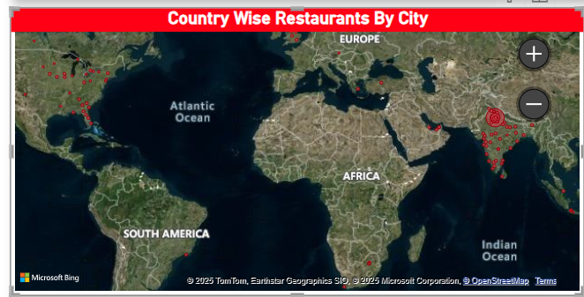
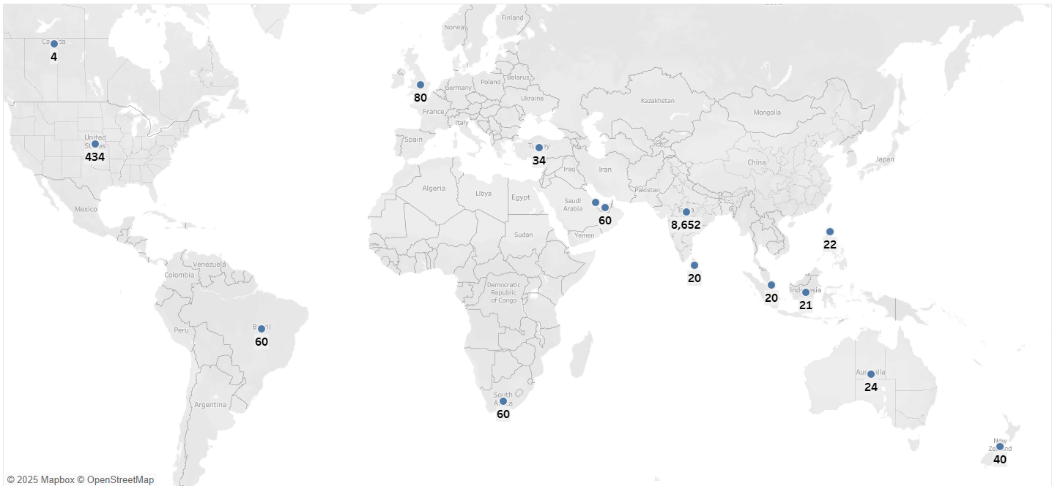
KPI 06. Restaurant count by Country and City
Country Wise Restaurants

Slide 10
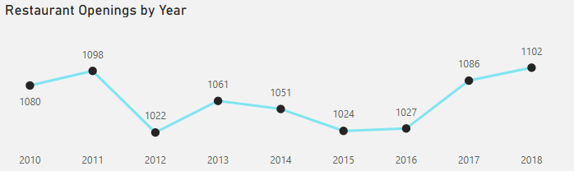
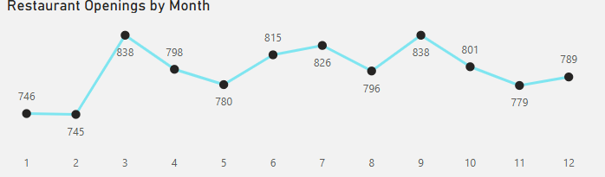
KPI 07. Restaurants opening based on Year , Month , Quarter
Restaurants Opening Based on Year – KPI Data Points (2010-2018):-
1️⃣ Total New Restaurants Opened Per Year – Tracks the number of new restaurant listings on Zomato annually. 2️⃣ Year-over-Year (YoY) Growth Rate – Measures the percentage increase or decrease in restaurant openings compared to the previous year.
Key Insights :
Restaurants Opening Based on Month – KPI Data Points (2010-2018):-
1️⃣ Total New Restaurants Opened Per Month – Tracks the number of new restaurants listed on Zomato each month. 2️⃣ Monthly Growth Rate of Restaurant Openings – Measures the percentage increase or decrease in restaurant openings compared to the previous month. 3. Slowest Months for Restaurant Openings – Highlights months with the least number of new restaurant listings.
4. Seasonal Trends in Restaurant Openings – Analyzes if restaurant openings peak in certain seasons (e.g., summer vs. winter). 5. Monthly Restaurant Openings by Country – Tracks which months see the most restaurant openings in different countries. 6. Monthly Restaurant Openings by City – Identifies city-wise trends in restaurant launches. 7. Monthly Growth in Online-Enabled Restaurants – Measures how many new restaurants offer online ordering or table booking each month. 8. Impact of Festive or Holiday Seasons on Restaurant Openings – Evaluates how major holidays or events influence new restaurant launches.

Slide 11
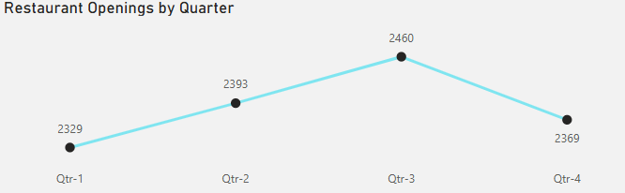
KPI 07. Restaurants opening based on Year , Month , Quarter
Restaurants Opening Based on Quarter – KPI Data Points (2010-2018):-
1️⃣ Total New Restaurants Opened Per Quarter – Tracks the number of new restaurant listings on Zomato every quarter. 2️⃣ Quarterly Growth Rate in Restaurant Openings – Measures the percentage increase or decrease compared to the previous quarter. 3️⃣ Top-Performing Quarter for Restaurant Openings – Identifies the quarter with the highest number of new restaurant listings. 4️⃣ Slowest Quarter for Restaurant Openings – Highlights the quarter with the least number of new restaurant additions. 5️⃣ Seasonal Trends in Restaurant Openings by Quarter – Analyzes whether restaurants open more frequently in specific quarters (e.g., Q1 vs. Q4). 6️⃣ Quarterly Restaurant Openings by Country – Tracks which quarters see the most new restaurant launches in different countries. 7️⃣ Quarterly Restaurant Openings by City – Identifies city-wise trends in restaurant openings across different quarters. 8️⃣ Quarterly Online-Enabled Restaurant Openings – Measures how many newly opened restaurants offer online ordering or table booking per quarter. 9️⃣ Comparison of Restaurant Openings in First Half (H1) vs. Second Half (H2) of the Year – Evaluates whether more restaurants open in the first or second half of the year. 🔟 Impact of Economic & Festive Seasons on Quarterly Restaurant Openings – Examines if economic factors or festivals drive more openings in specific quarters.
Key Insights :

Slide 12
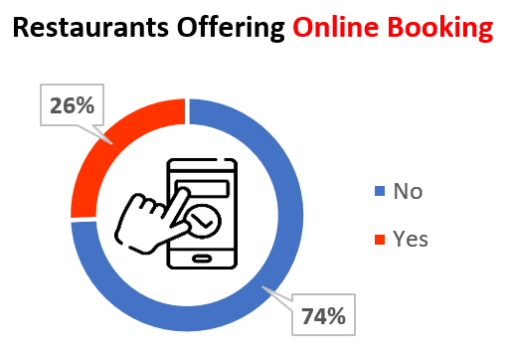
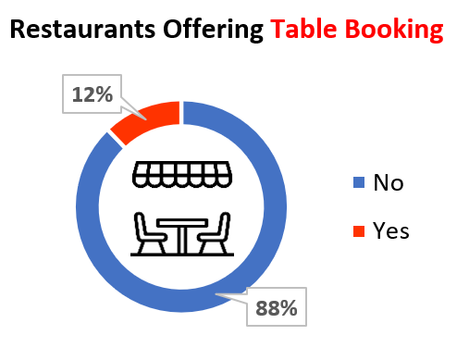
KPI 08. Percentage by “Has table booking” & “Has online delivery”
Zomato introduced its table reservation service, Zomato Book, in 2015, following the acquisition of the U.S.-based platform Nex Table.
The service was initially launched in India, Australia, and the UAE. By 2018, Zomato facilitated 10.5 million online table reservations, averaging nearly a million bookings per month.
For more detailed data on the number of restaurants offering table booking services through Zomato between 2015 and 2018, accessing Zomato's internal records or detailed financial reports would be necessary.
Key Insights :
Indian Dises :
Zomato introduced its table booking service in 2016, following the acquisition of the U.S.-based platform Nex Table, which was rebranded as Zomato Book. This feature allowed users to make, modify, and cancel reservations seamlessly through the Zomato app.
In 2018, the platform facilitated 10.5 million online table reservations, averaging nearly a million bookings per month. This significant growth indicates a strong user adoption of the service within two years of its launch.
For more granular data on the number of restaurants offering table booking services through Zomato between 2016 and 2018, accessing Zomato's internal records or detailed financial reports would be necessary.

Slide 13
Tools
Used
Excel
Tableau
Power BI
SQL

Slide 14
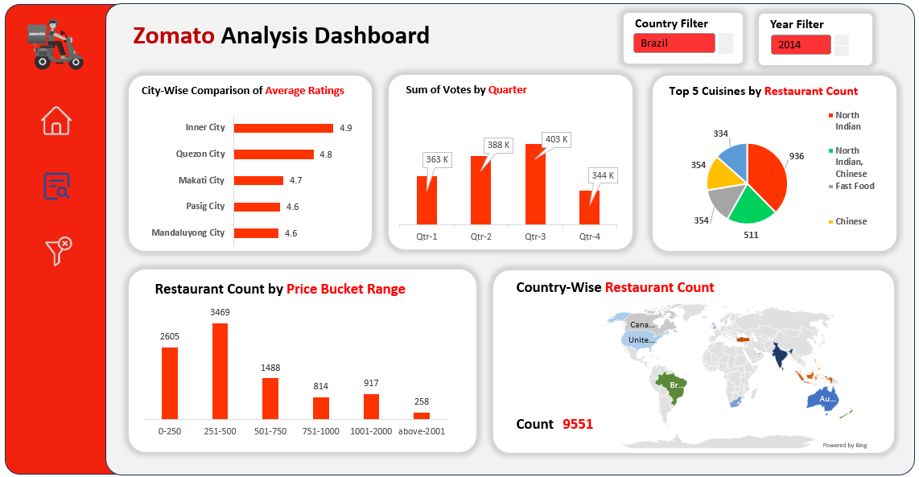
Excel Dashboard

Slide 15
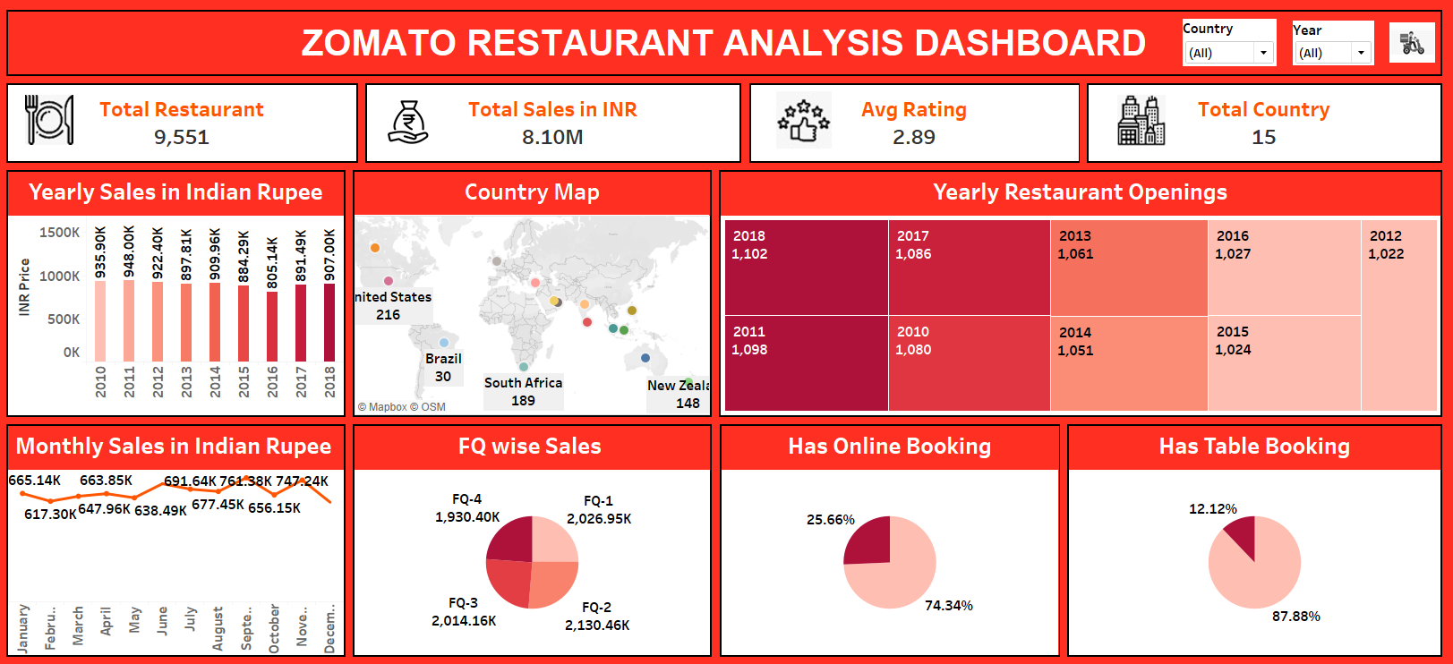
Tableau Dashboard

Slide 16
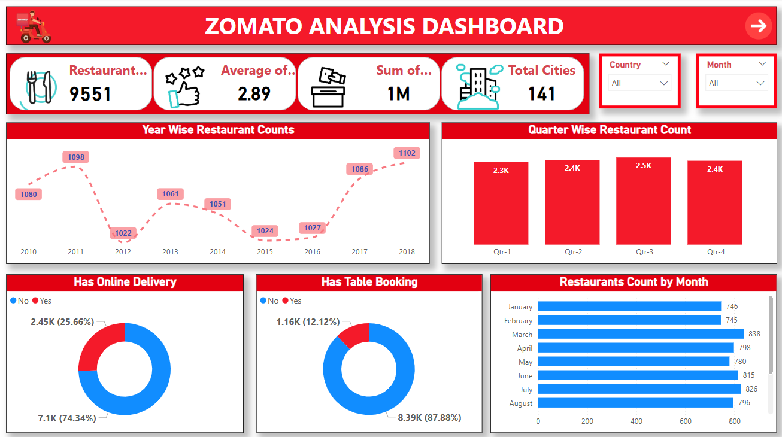
Power BI Dashboard

Slide 17
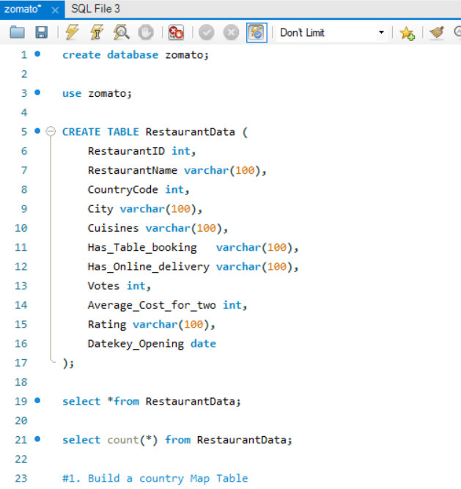
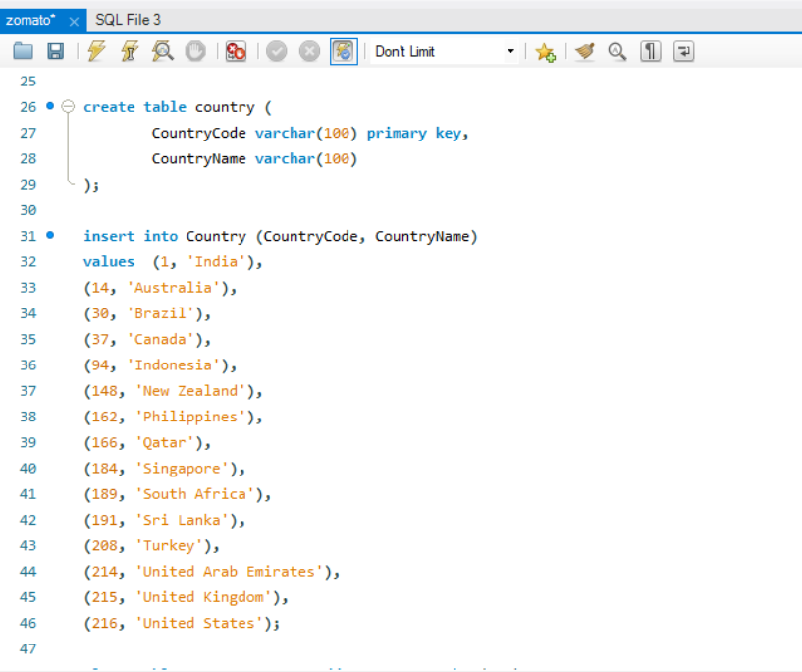
SQL Query

Slide 18

Recommendations
Number of restaurants by Country
Expand in High-Growth Countries
Target Local Preferences
Evaluate Competition
2. Count of Restaurants by Rating
Improve Customer Experience
Encourage Reviews
Monitor and Respond to reviews
3. Number of Restaurants by Opening year, Month, and Quarter
Focus on Seasonality Trends
Continues Innovation
Plan Operational Resources
4. Restaurant Bucket Analysis Based on Average Price
Diversity Pricing Strategy
Marketing Strategies Based on a Bucket
Bdjust Offerings by Region.

Slide 19
Conclusions:
📌 Conclusion: Zomato’s Restaurant Growth (2010-2018):-
1️⃣ Consistent Year-over-Year Growth – Zomato experienced a steady increase in restaurant listings from 2010 to 2018, showing strong market adoption.
2️⃣ Global Expansion Across Multiple Countries & Cities – The platform expanded its presence in various regions, adding restaurants in both established and emerging markets.
3️⃣ Peak Growth Periods Identified – Certain years and quarters witnessed higher restaurant openings, influenced by market trends, investments, and regional demand.
4️⃣ Seasonal Impact on Openings – Monthly and quarterly trends revealed that restaurant openings peaked during specific times of the year, possibly aligning with festive seasons and economic cycles.
5️⃣ Increased Adoption of Online Services – A growing number of restaurants integrated online ordering and table booking features, reflecting the shift towards digital restaurant services.
6️⃣ Urban-Centric Expansion – Major cities saw the highest concentration of new restaurant listings, highlighting Zomato’s focus on urban markets with higher consumer demand.
7️⃣ New Market Penetration – Over the years, Zomato entered new cities and countries, significantly increasing its market presence and user base.

Slide 20

Thank you

